Slide 1

Lauren Gowland - Newcastle City Council
Simon Edwards - Newcastle University

Slide 2
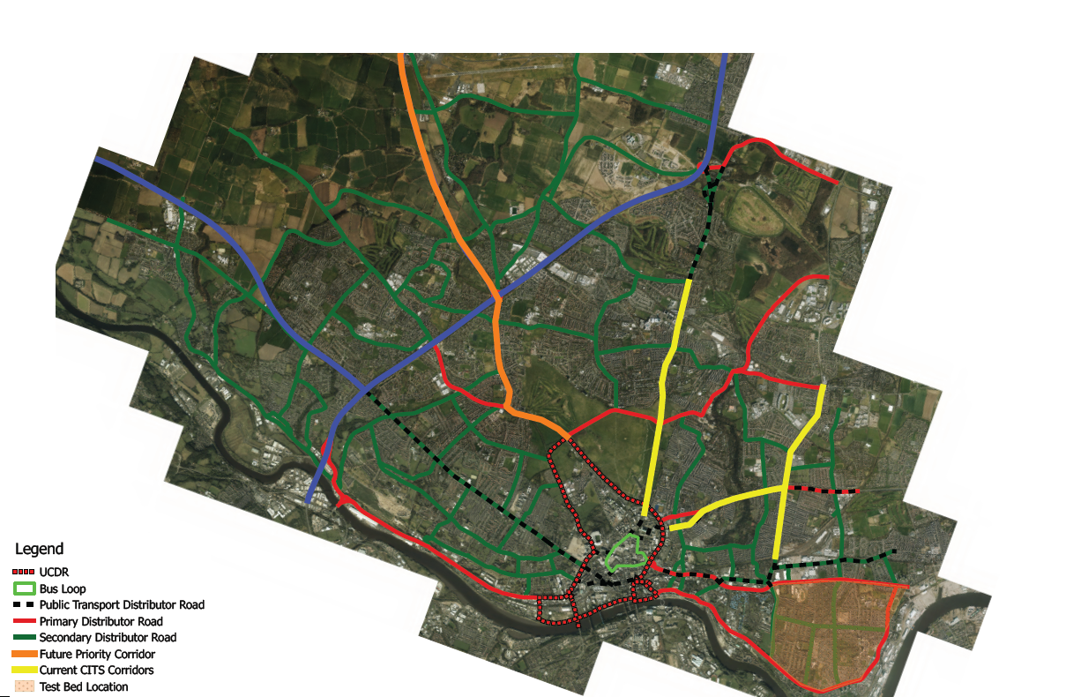


Slide 3
Newcastle’s Perspective
What can C-ITS do for our city?
  Smoother traffic flow
  Better network management
  Air Quality improvements
  Journey time reliability
  Improved user experience
  Safety benefits
  Economic benefits

Slide 4
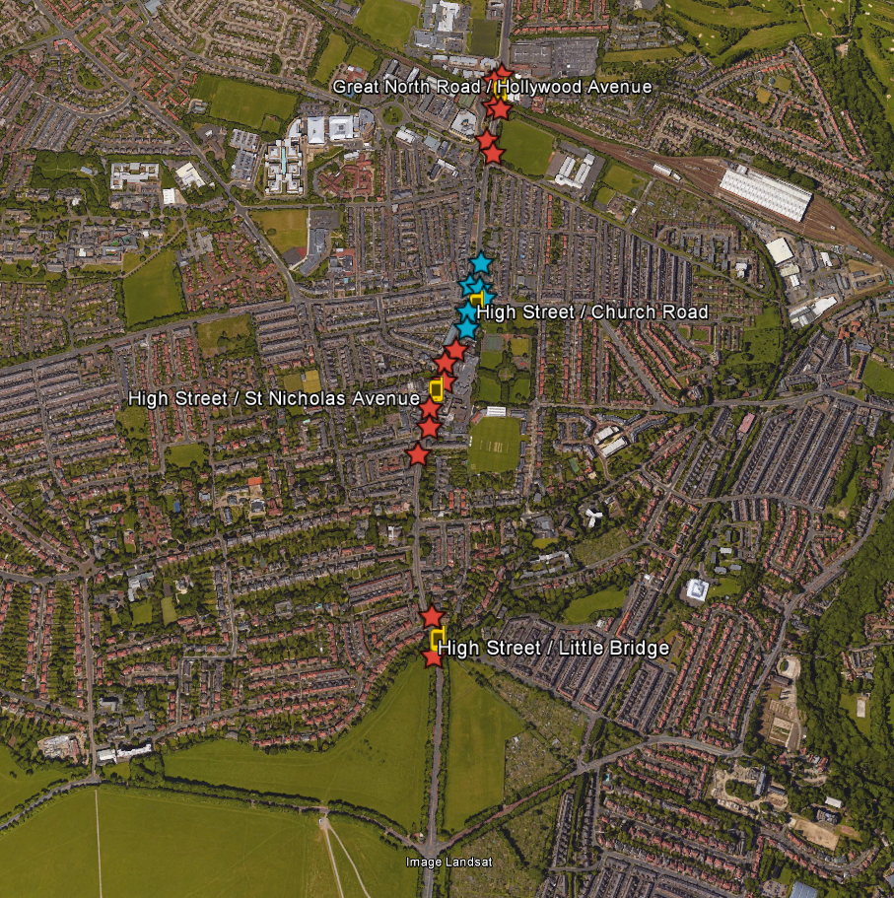
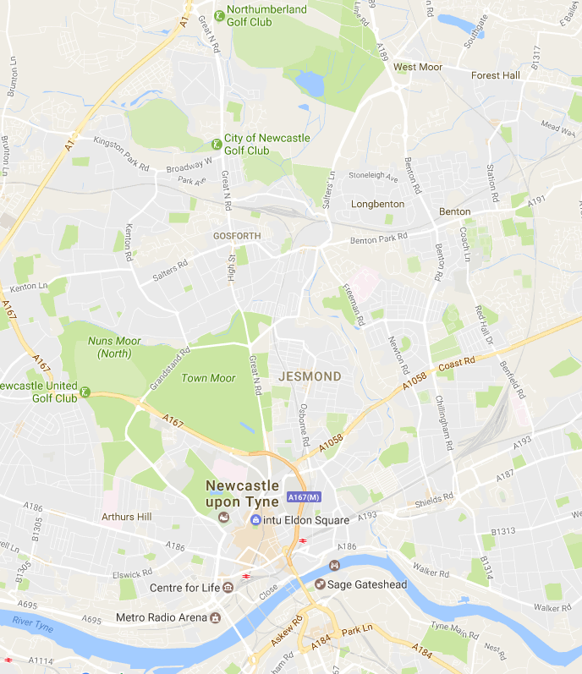
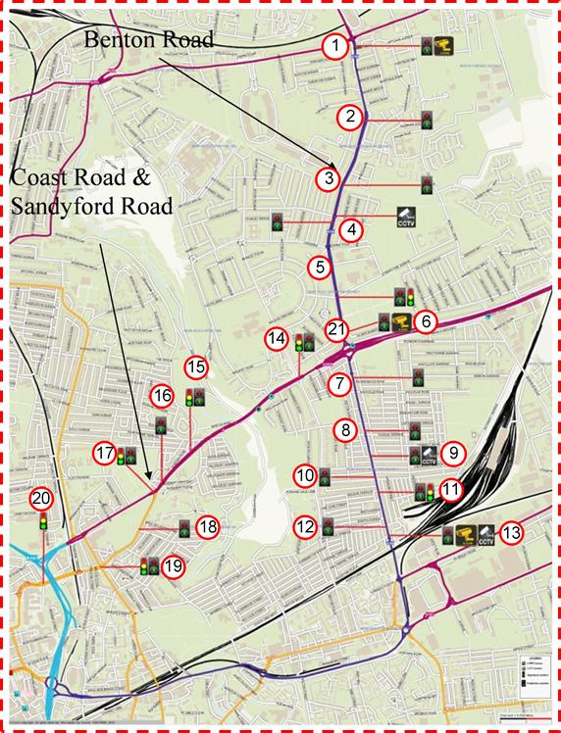

Slide 5
Compass 4D – Chillingham Road
EU funded project between 2013 – 2016
Equipped 21 junctions with Road Side Units and 11 North East Ambulance Service non-emergency patient transfer vehicles with OBUs
Energy Efficient Intersection Service (EEIS)
  Green Light Optimal Speed Advisory (GLOSA)
  Green priority
  Idling support

Slide 6
C-ITS Smart Corridor– Gosforth Corridor
DfT funded project 2016 - 2018
Equips 18 junctions on Great North Road with Road Side Units and 35 ARRIVA express buses
Energy Efficient Intersection Service (EEIS)
  Green Light Optimal Speed Advisory (GLOSA)
  Green priority
  Idling support
  Plus, additional air quality monitoring and modelling
  Upgraded RSUs, OBUs, and HMIs
  Greater focus on subjective evaluation of drivers’ usability/ acceptance
Road Hazard Warning
VRUs

Slide 7
C-ITS Lessons Learned
Availability and volume of data
User Acceptance and Buy-In
Procurement & Lead Times
Legal Agreements & Testing Schedules
Compatibility and Interoperability

Slide 8
CMobILE Project
Accelerating C-ITS Mobility Innovation and depLoyment in Europe
  EU H2020
  37 partners
  42 months
  12.5m Euros
  Pilot sites: Barcelona; Bilbao; Bordeaux; Copenhagen; Newcastle; North Brabant; Thessaloniki; Vigo
  All existing users, plus OBUs / HMIs for additional vehicles (e.g. freight / taxi)
  Personal Units (smartphones) for VRUs
  Upgrade the Newcastle C-ITS system to the latest standards

Slide 9
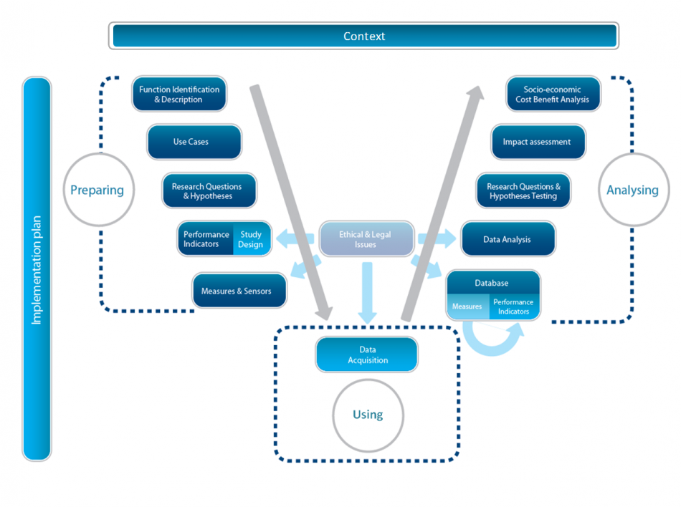
C-ITS Evaluation Framework
FESTA:
Field opErational teSt supporT Action
Assessing the effect of a scheme in the real world is different, and more difficult, to either:
  Controlled Trials
  Simulations
However there exists a structured methodological framework for dealing with this

Slide 10
C-ITS Evaluation Framework
Determine the effect you are trying to measure
  Can you reliably measure this?
Create a suitable measurement for this effect, which will be statistically verifiable
  Will the expected change show up in the project timeframe?
Reducing variability in the Operational and Baseline groups
  We don’t have a controlled study, so we must reduce variability in other ways
We might be interested in how the scheme affects certain pollutants but these might be very difficult to measure accurately. Can we substitute other pollutants?
Does the scheme affect accident rates? We can only measure this if we expect multiple accidents in the life time of the project.
We must use techniques to reduce the experimental “noise”, including fully representative baseline and operational phases

Slide 11
C-ITS Evaluation: Gosforth CITS
  Bus:
  Measure the sustained improvement over multiple bus routes through monitoring GPS traces, bus timings, fuel consumption.
  We have lots of easy to measure data from good sources with little “noise”.
  Subjective:
  Examine user acceptance and usage of cycle alert scheme and EEIS.
  Reliant on self reporting and attitudinal surveys. Might be difficult to give definitive answers.
  Air Quality:
  Measure the air quality in and around the pilot site through a combination of precision and low cost monitors.
  Lots of data, but the data is very “noisy”/ quality of sensors variable. A change in wind direction can alter pollution measurements.
  Simulations:
  Simulate expected results from the scheme and compare them to real world measurements.
  Lots of good quality data but it isn’t “real”. How applicable is it to the real world?

Slide 12
Key Contacts
Lauren Gowland - lauren.gowland@newcastle.gov.uk
Ray King – ray.king@newcastle.gov.uk
Simon Edwards – simon.edwards@newcastle.ac.uk
Graeme Hill – g.a.hill@newcastle.ac.uk

